Slide 1
Algoritma dan Struktur Data
Ilustrasi Binary Tree untuk Ekspresi Aritmatika
Ali Ridho Barakbah
Umi Sa’adah
Tita Karlita
2021

Slide 2
( A + B ) * ( ( B – C ) + D )
( A +₁ B ) * ( ( B – C ) + ₂ D )
operator
operan

Slide 3
( A + ₁ B ) * ( ( B – C ) + ₂ D )
Push ( ke stack operator
(
operator
operan

Slide 4
( A + ₁ B ) * ( ( B – C ) + ₂ D )
Push A ke stack operan
(
A
operator
operan

Slide 5
( A + ₁ B ) * ( ( B – C ) + ₂ D )
Push + ₁ ke stack operator
+ ₁
(
A
operator
operan

Slide 6
( A + ₁ B ) * ( ( B – C ) + ₂ D )
Push B ke stack operan
+ ₁
B
(
A
operator
operan

Slide 7
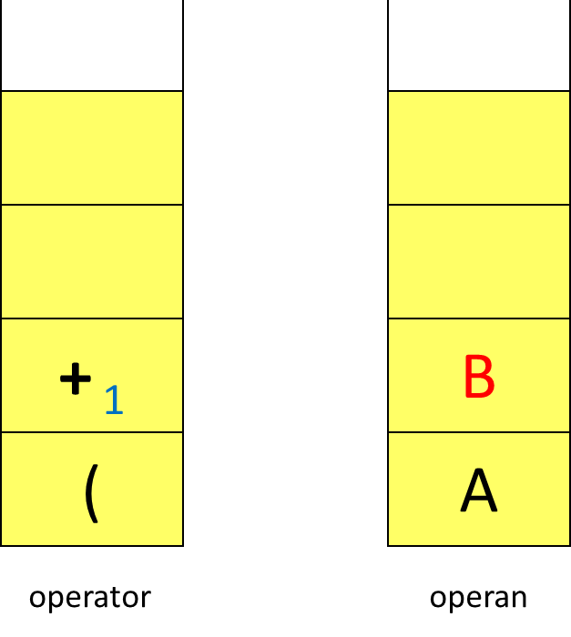
( A +₁ B ) * ( ( B – C ) +₂ D )
pop operator
pop operan, taruh di kanan
pop operan, taruh di kiri
push operator di stack operan
pop operator, abaikan
+₁
+₁
A
B
operator
operan

Slide 8
( A + ₁ B ) * ( ( B – C ) + ₂ D )
Push * ke stack operator
*
+ ₁
+₁
operator
operan
A
B

Slide 9
( A + ₁ B ) * ( ( B – C ) + ₂ D )
Push ( ke stack operator
(
*
+ ₁
+ ₁
operator
operan
A
B

Slide 10
( A + ₁ B ) * ( ( B – C ) + ₂ D )
Push ( ke stack operator
(
(
*
+ ₁
+ ₁
operator
operan
A
B

Slide 11
( A + ₁ B ) * ( ( B – C ) + D )
Push B ke stack operan
(
(
B
*
+ ₁
+ ₁
operator
operan
A
B

Slide 12
( A + ₁ B ) * ( ( B – C ) + ₂ D )
Push – ke stack operator
-
(
(
B
*
+ ₁
+ ₁
operator
operan
A
B

Slide 13
( A + ₁ B ) * ( ( B – C ) + ₁ D )
Push C ke stack operan
-
(
C
(
B
*
+ ₁
+ ₁
operator
operan
A
B

Slide 14
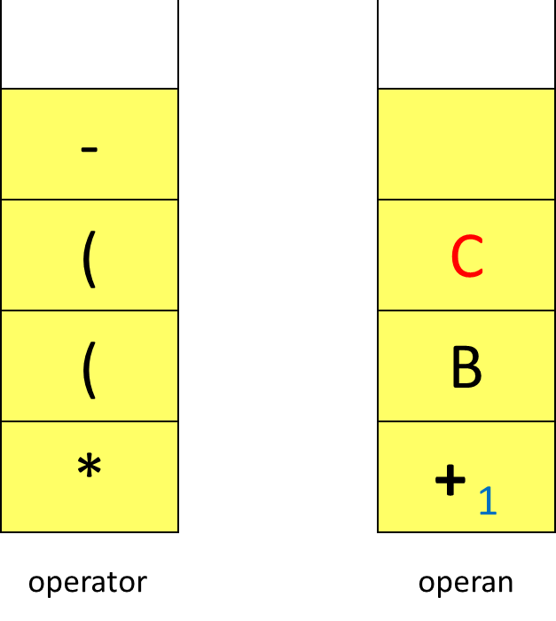
( A + ₁ B ) * ( ( B – C ) + ₂ D )
pop operator
pop operan, taruh di kanan
pop operan, taruh di kiri
push operator di stack operan
pop operator, abaikan
(
-
+ ₁
-
*
+ ₁
A
B
B
C
operator
operan

Slide 15
( A + ₁ B ) * ( ( B – C ) + ₂ D )
Push + ₂ ke stack operator
+ ₂
(
-
*
+
+ ₁
-
operator
operan
A
B
B
C

Slide 16
( A + ₁ B ) * ( ( B – C ) + ₂ D )
Push D ke stack operan
+ ₂
D
(
-
*
+ ₁
+ ₁
-
operator
operan
A
B
B
C

Slide 17
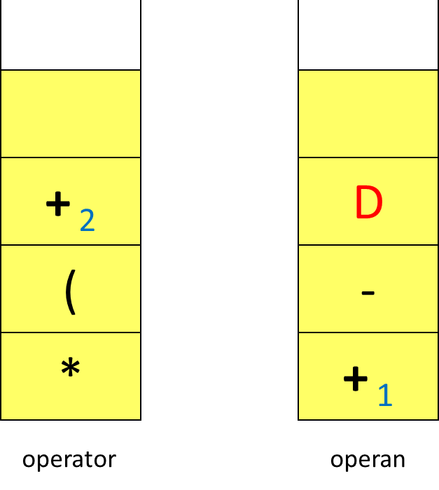
( A + ₁ B ) * ( ( B – C ) + ₂ D )
pop operator
pop operan, taruh di kanan
pop operan, taruh di kiri
push operator di stack operan
pop operator, abaikan
+ ₂
+ ₂
+ ₁
-
D
*
+ ₁
A
B
B
C
operator
operan

Slide 18
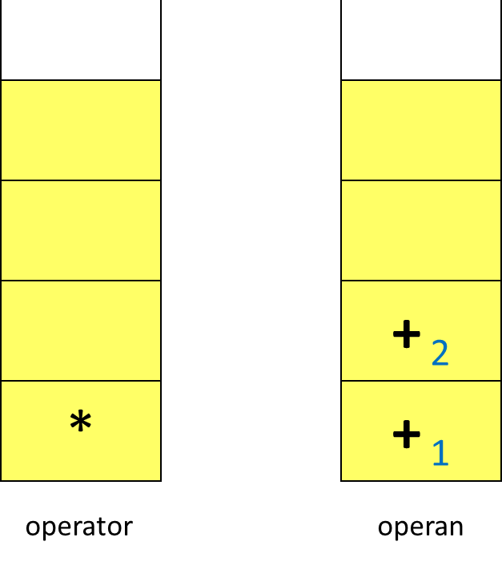
( A + ₁ B ) * ( ( B – C ) + ₂ D )
Akhir notasi infix telah tercapai.
Selama stack Operator dan stack Operan belum kosong, lakukan
pop operator
pop operan, taruh di kanan
pop operan, taruh di kiri
*
+ ₁
+ ₂
A
B
-
D
B
C
operator
operan

